Slide 1
In The Name Of God
Title: The Neilsen’s 10 Heuristics Project
Description: In this project, I will check Nelsen’s 10 Heuristics in A) a Mobile Application, B) a Website Page, and C) a Physical Object.
Author: Alireza Hadipoor
Date: 2024/07/23
Email: alirzahadipur@gmail.com
*Inspired by the “Introduction to User Experience Principles and Processes” from the University of Michigan.

Slide 2
Part A: Check The Neilsen’s Heuristics in a Mobile Application
Source: Xiaomi Music App
Heuristics are:
Visibility Of System Status
Match Between System And Real World
User Control And Freedom
Consistency And Standards
Error Prevention
Recognition Over Recall
Flexibility And Efficiency Of Use
Aesthetic And Minimalist Design
Error Diagnostic And Recovery
Documentation And Help
Severity Levels are:
Negligible(You Don’t Have To Change It)
Minor(Change It When You Have Time)
Major(Change It As Soon As Possible)
Catastrophe(Change It Today)

Slide 3
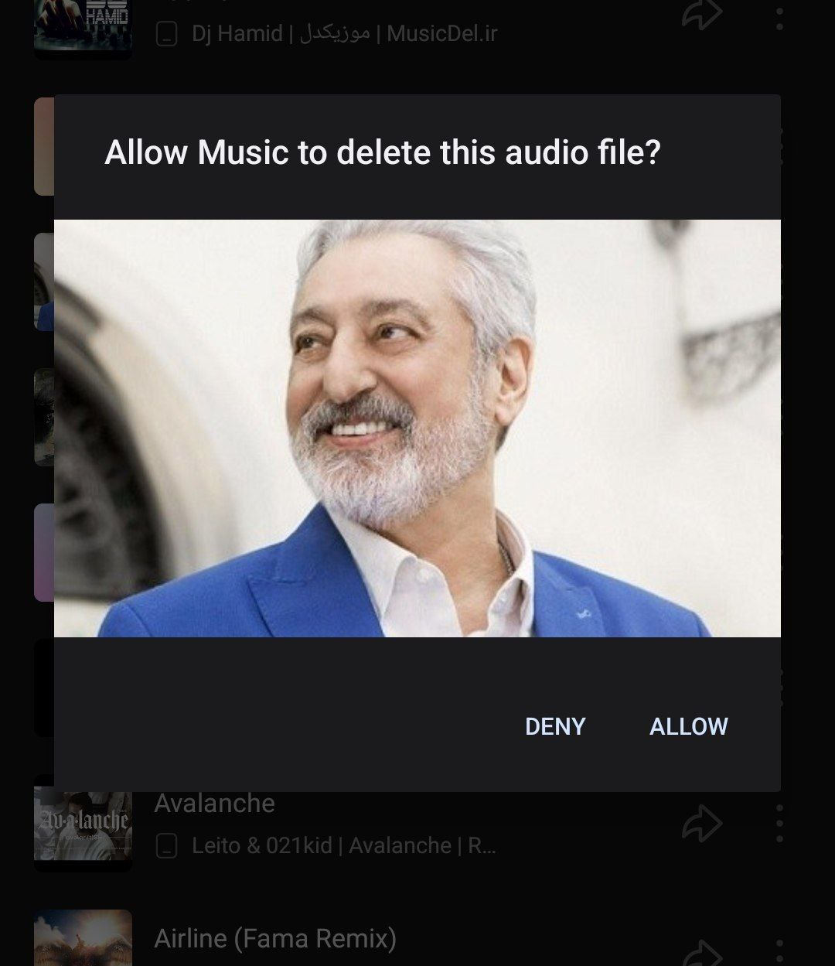
Finding 1: After deleting a song you can’t recover it.
Severity: 3 (Major Problem)
Heuristic Violated: User Control And Freedom(The Third Heuristic).
Description: If users delete a song and after a while want to recover that song or voice they are not able to do that.
Recommendation: Consider a folder called “deleted items” so if users want to recover their songs they can approach this folder.

Slide 4
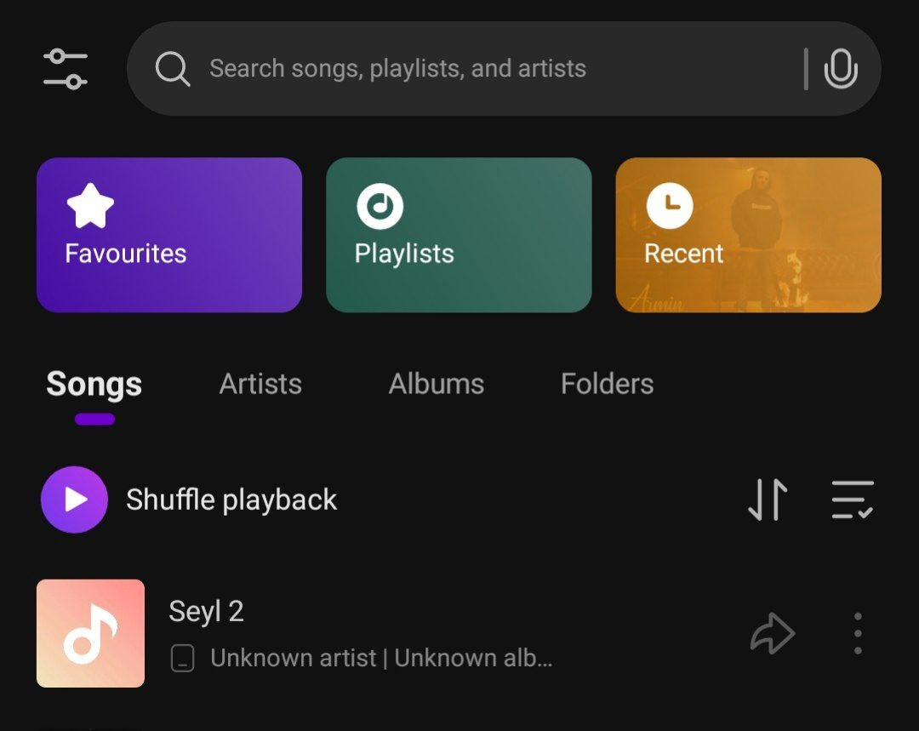
Finding 2: The app doesn’t contain some important features.
Severity: 3 (Major Problem)
Heuristic Violated: Consistency And Standards(The Fourth Heuristic).
Description: Almost all music player apps have two important categories of songs “Recently Added” and “Genre”. This app misses these two categories so if users want to listen to music based on their recently added music or based on genre they can’t.
Recommendation: Add both of these two categories so users can have all the important categories together(Currently the app has just three categories).

Slide 5
Part B: Check The Neilsen’s Heuristics On a Web page
Source: The Boursieplus main page
Heuristics are:
Visibility Of System Status
Match Between System And Real World
User Control And Freedom
Consistency And Standards
Error Prevention
Recognition Over Recall
Flexibility And Efficiency Of Use
Aesthetic And Minimalist Design
Error Diagnostic And Recovery
Documentation And Help
Severity Levels are:
Negligible(You Don’t Have To Change It)
Minor(Change It When You Have Time)
Major(Change It As Soon As Possible)
Catastrophe(Change It Today)

Slide 6
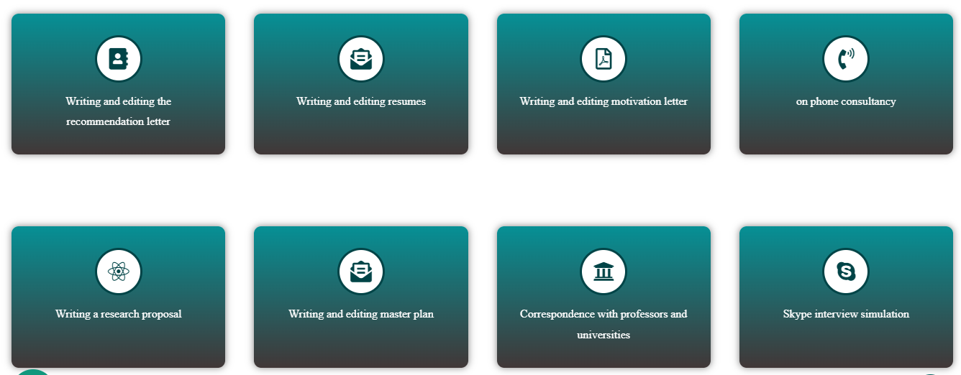


Finding 1: Using inappropriate icons for services.
Severity: 2 (Minor Problem)
Heuristic Violated: Match Between System And Real World(The Second Heuristic).
Description: The Icons shown in the image are not sensible compared to the text below them. Moreover, some icons are the same, while the services are different.
Recommendation: Use more sensible and clearer icons based on the services.

Slide 7
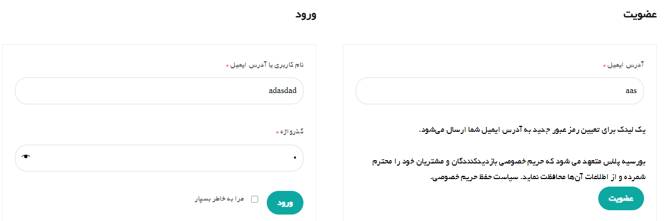
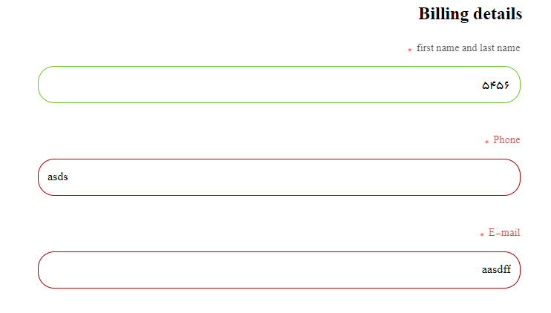
Finding 2: The website doesn’t prevent errors from happening.
Severity: 3 (Major Problem)
Heuristic Violated: Error Prevention(The Fifth Heuristic).
Description: The input boxes don’t have any sign for entering invalid inputs. However, in the other part of the website(purchasing services), this website implements some features to prevent errors from happening.
Recommendation: Use signs to prevent errors from happening and unify the website’s input boxes.
Invalid text was entered
The other part of the website: 2 text boxes have the feature and 1 does not(I entered a number in the name section).

Slide 8
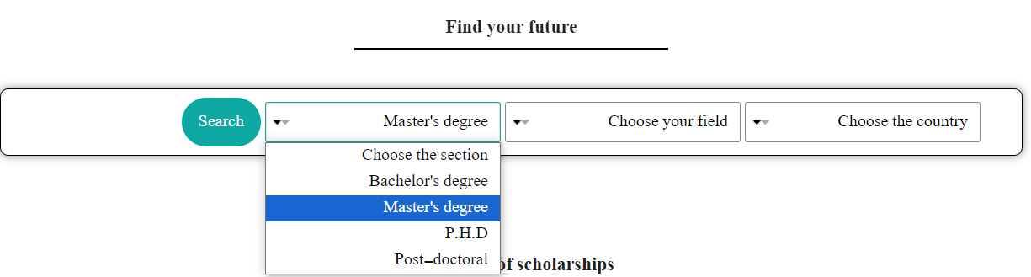
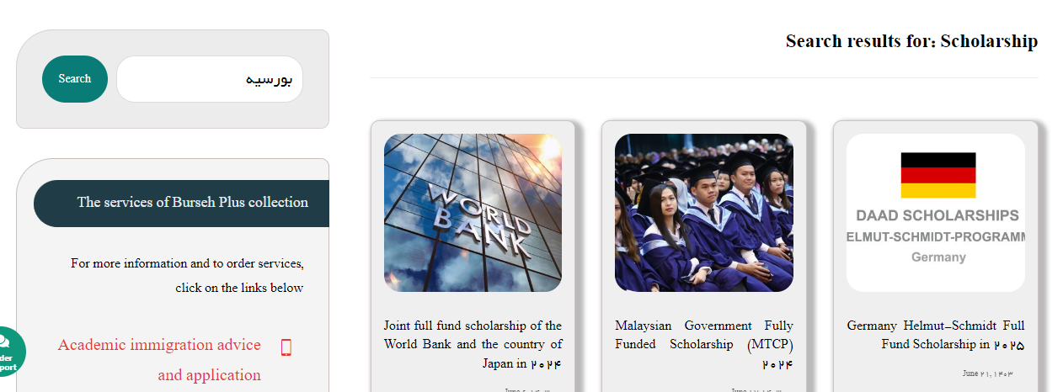
Finding 3: Important Information has not been shown in the search result.
Severity: 3 (Major Problem)
Heuristic Violated: Recognition Over Recall(The Sixth Heuristic).
Description: Users should be able to see their selected options after searching. They have to know what they selected and be able to easily change their selection to see different results.
Recommendation: Designers should design a dynamic result page where users can see what they have chosen and how they can change it. Users need filters to reduce options and expedite their search.
For example, you select the <<Masters Degree>> and hit on the search button.
This is the result page. You cannot see what you selected and how can change it. You should back to the previous page and start your search from the beginning.
*Incorrect spelling: Master’s Degree

Slide 9
Part C: Check The Neilsen’s Heuristics on a Physical Object
Source: Dish Washer Machine
Heuristics are:
Visibility Of System Status
Match Between System And Real World
User Control And Freedom
Consistency And Standards
Error Prevention
Recognition Over Recall
Flexibility And Efficiency Of Use
Aesthetic And Minimalist Design
Error Diagnostic And Recovery
Documentation And Help
Severity Levels are:
Negligible(You Don’t Have To Change It)
Minor(Change It When You Have Time)
Major(Change It As Soon As Possible)
Catastrophe(Change It Today)

Slide 10
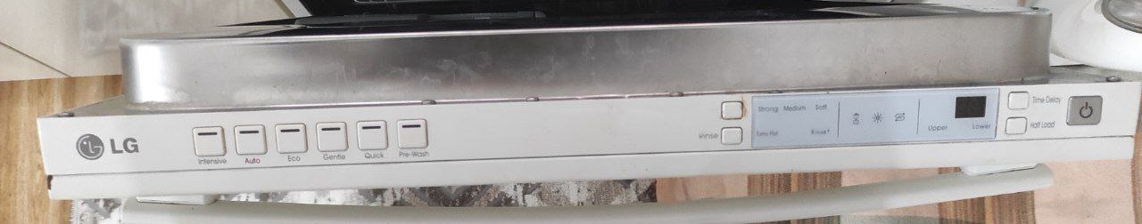
Finding 1: Ambiguous Functionality
Severity: 4 (Catastrophe Problem)
Heuristic Violated: Match Between System And Real World(The Second Heuristic).
Description: The functionality of buttons isn’t obvious for infrequent users. Designers used icons that aren’t obvious that much. So users can be misled easily.
Recommendation: Use icons and buttons to navigate the users when they working with the dishwasher.
Finding 2: The system doesn’t Support Redo And Undo functionality
Severity: 3 (Major Problem)
Heuristic Violated: User Control And Freedom(The Third Heuristic).
Description: Users aren’t able to redo or undo their work. They can’t change their selected action.
Recommendation: By implementing features like stop, redo, undo, change the action, etc. can have a better user experience.

Slide 11
Finding 3: The state of the machine is not visible.
Severity: 3 (Major Problem)
Heuristic Violated: Recognition Over Recall(The Sixth Heuristic).
Description: Users aren’t able to see what the machine is doing and whether it receives users’ input or not. Moreover, it’s not obvious how much time remains to finish the operation, until users open the door of the machine. In this way, the machine would be stopped.
Recommendation: Implementing the user interface outside of the machine(like on the door) not in the door.
Finding 4: The user interface is not user-friendly.
Severity: 2 (Minor Problem)
Heuristic Violated: Aesthetic And Minimalist Design(The Eighth Heuristic).
Description: The interface is not user-friendly it is located in the door(when users open the door can see the interface) and it isn’t pretty obvious what the buttons do.
Recommendation: Implementing the user interface outside of the machine(like on the door) not in the door. And make it more user-friendly.

Slide 12
